Slide 1
Basic Linux Training
By Mahidul Hasan

Slide 2
Class Schedule
Class | Topics | Date | Note
0 | History of Operating System, Functions of OS | 28-03-2021 | Concept
1 | Introduction of Linux | 28-03-2021 | Concept
2 | The LINUX Filesystem and Shell Intro | 04-04-2021 | Concept
3 | Basic Linux/Unix Commands with Examples | 11-04-2021 | Concept & practical
4 | Lab#1: Hands on practice on Linux/Unix Commands | 11-04-2021 | We will use Oracle virtual machine
5 | User and Directory Permission | 18-04-2021 | Concept & practical
6 | Shell Scripting | 25-04-2021 | Concept & practical
7 | Lab#2: Hands on practice on Shell Scripting | 25-04-2021 | Concept & practical

Slide 3
Lecture 0
History of Operating System, Functions of OS

Slide 4
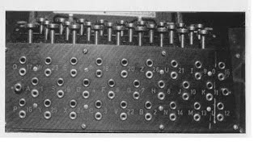
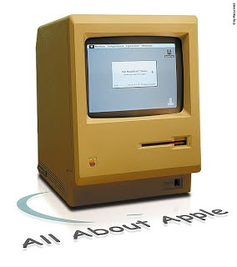
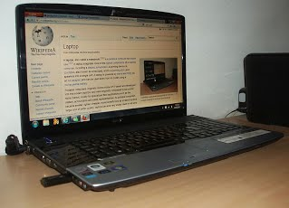
History of Operating System, Functions of OS
Operating systems were first developed in the late 1950s to manage tape storage
The General Motors Research Lab implemented the first OS in the early 1950s for their IBM 701
In the mid-1960s, operating systems started to use disks
In the late 1960s, the first version of the Unix OS was developed
The first OS built by Microsoft was DOS. It was built in 1981 by purchasing the 86-DOS software from a Seattle company
The present-day popular OS Windows first came to existence in 1985 when a GUI was created and paired with MS-DOS.
Open source Linux developed around 1991 by Linus Torvalds
The First Generation (1940's to early 1950's)
The Third Generation (1965-1980)
The Fourth Generation (1980-Present Day)

Slide 5
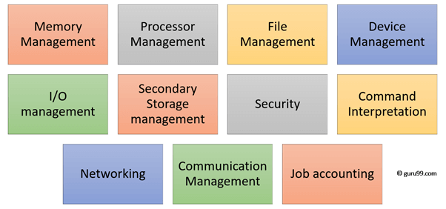
Functions of Operating System

Slide 6
Functions of Operating System
In an operating system software performs each of the function:
Process management:- Process management helps OS to create and delete processes. It also provides mechanisms for synchronization and communication among processes.
Memory management:- Memory management module performs the task of allocation and de-allocation of memory space to programs in need of this resources.
File management:- It manages all the file-related activities such as organization storage, retrieval, naming, sharing, and protection of files.
Device Management: Device management keeps tracks of all devices. This module also responsible for this task is known as the I/O controller. It also performs the task of allocation and de-allocation of the devices.
I/O System Management: One of the main objects of any OS is to hide the peculiarities of that hardware devices from the user.
Secondary-Storage Management: Systems have several levels of storage which includes primary storage, secondary storage, and cache storage. Instructions and data must be stored in primary storage or cache so that a running program can reference it.
Security:- Security module protects the data and information of a computer system against malware threat and authorized access.
Command interpretation: This module is interpreting commands given by the and acting system resources to process that commands.
Networking: A distributed system is a group of processors which do not share memory, hardware devices, or a clock. The processors communicate with one another through the network.
Job accounting: Keeping track of time & resource used by various job and users.
Communication management: Coordination and assignment of compilers, interpreters, and another software resource of the various users of the computer systems.

Slide 7
Difference between Firmware and Operating System
Firmware | Operating System
Firmware is one kind of programming that is embedded on a chip in the device which controls that specific device. | OS provides functionality over and above that which is provided by the firmware.
Firmware is programs that been encoded by the manufacture of the IC or something and cannot be changed. | OS is a program that can be installed by the user and can be changed.
It is stored on non-volatile memory. | OS is stored on the hard drive.

Slide 8
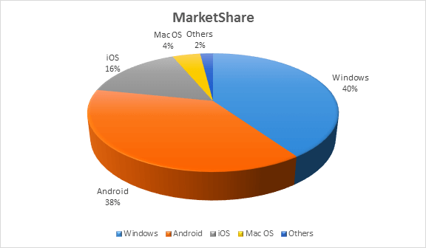
Market share of different type of OS

Slide 9
Difference between Windows, Linux and MacOS
TOPIC/OS | LINUX | MACOS | WINDOWS
Developed by | Linus Torvalds | Apple Incorporation | Windows Incorporation
Launched | 1991 | 2001 | 1985
Target system | embedded systems, mobile devices, personal computers, servers, mainframe computers and supercomputers | workstation, personal computers and embedded systems | workstation, personal computers, media center, tablets and embedded systems
Architectures supported | are IA-32, x86-64, ARM, PowerPC and SPARC. | Ax86-64(10.4.7-present), IA-32(10.4.4-10.6.8) and PowerPC(10.0-10.5.8). | IA-32, x86-64, IA-64, ARM, Alpha, MIPS and PowerPC
Kernel type | Monolithic | Hybrid with modules | Hybrid with modules
Native APIs | LINUX/POSIX | Carbon, Cocoa, Java and BSD-POSIX | Win32 and NT API
Supported non-native APIs | Mono, Java, Win16 and Win32 | Toolbox, Win16 and Win32 | Mono, Java, Win16 and Win32
license | GNU GPLv2 (kernel) | Proprietary, APSL and GNU GPL | Proprietary
package management | depends on the distribution (.deb, .rpm) | macOS installer | MSI or custom installer
Supported File systems | ext2, ext3, ext4, xfs, btrfs, ReiserFS, FAT, ISO 9660, UDF and NFS. | HFS+, APFS, HFS, UFS, AFP, ISO 9660, FAT, UDF, NFS, SMBFS, NTFS, FTP, WebDAV and ZFS. | NTFS, FAT, ISO 9660, UDF, HFS+, FATX and HFS

Slide 10
Lecture 1
Introduction of Linux

Slide 11
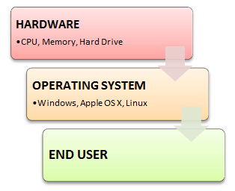
What is Linux?
LINUX is an operating system or a kernel distributed under an open-source license. Its functionality list is quite like UNIX. The kernel is a program at the heart of the Linux operating system that takes care of fundamental stuff, like letting hardware communicate with software.

Slide 12
Linux Distributions
There are thousands of Linux distribution available. Here are some popular ones.
Debian: It is a stable and popular non-commercial Linux distribution. It is widely used as a desktop Linux Distro and is user-oriented. It strictly acts within the Linux protocols.
Ubuntu: This is the third most popular desktop operating system after Microsoft Windows and Apple Mac OS. It is based on the Debian Linux Distribution, and it is known as its desktop environment.
CentOS: It is one of the most used Linux Distribution for enterprise and web servers. It is a free enterprise class Operating system and is based heavily on Red Hat enterprise Distro.
RedHat enterprise: Another popular enterprise based Linux Distribution is Red Hat Enterprise.It has evolved from Red Hat Linux which was discontinued in 2004. It is a commercial Distro and very popular among its clientele.

Slide 13
Why learning linux is important?
Being open-source, anyone with programming knowledge can modify it.
It is easy to learn Linux
The Linux operating systems now offer millions of programs/applications and Linux softwares to choose from, most of them are free!
Once you have Linux installed you no longer need an antivirus! Linux is a highly secure system. More so, there is a global development community constantly looking at ways to enhance its security. With each upgrade, the OS becomes more secure and robust
Linux freeware is the OS of choice for Server environments due to its stability and reliability (Mega-companies like Amazon, Facebook, and Google use Linux for their Servers).
A Linux based server could run non-stop without a reboot for years on end.

Slide 14
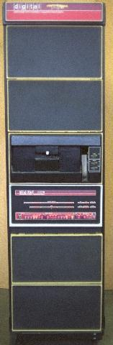
History (In the Beginning)
UNICS: 1969 – PDP-7 minicomputer
PDP-7 goes away, rewritten on PDP-11 to “help patent lawyers”
V1: 1971
V3: 1973 (pipes, C language)
V6: 1976 (rewritten in C, base for BSD)
V7: 1979 (Licensed, portable)
PDP-11

Slide 15

History (In the Beginning)
Linux
Written in 1991 by Linus Torvalds
Most popular UNIX variant
Free with GNU license
BSD Lite
FreeBSD (1993, focus on PCs)
NetBSD (1993, focus on portability)
OpenBSD (1996, focus on security)
Free with BSD license
Development less centralized

Slide 16
Lecture 2
The LINUX Filesystem and Shell Intro

Slide 17
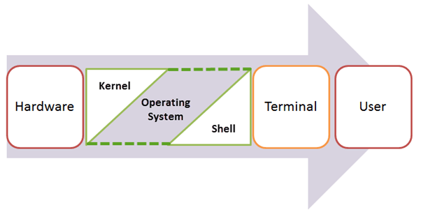
Linux System Structure

Slide 18
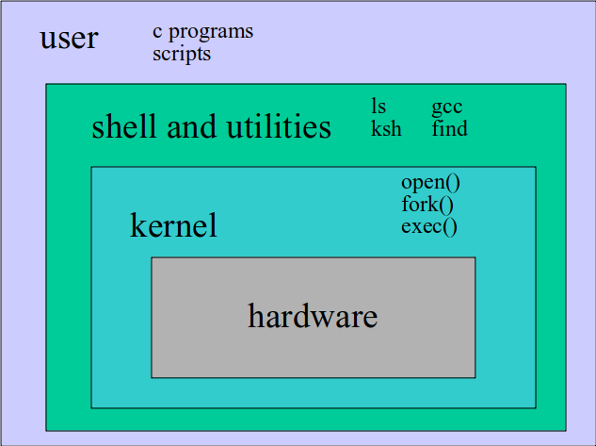
Linux System Structure

Slide 19
How Kernel works? (Kernel Subsystems)
File system
Deals with all input and output
Includes files and terminals
Integration of storage devices
Process management
Deals with programs and program interaction
How processes share CPU, memory and signals
Scheduling
Interprocess Communication
Memory management
UNIX variants have different implementations of different subsystems.

Slide 20
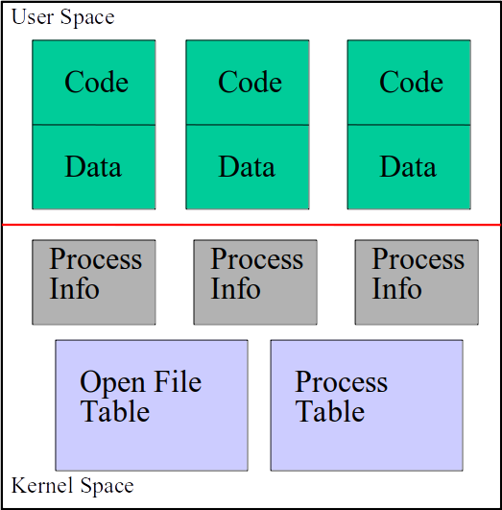
How Kernel works? (Kernel Data Structures)
Information about each process.
Process table: contains an entry for every process in the system.
Open-file table: contains at least one entry for every open file in the system.

Slide 21
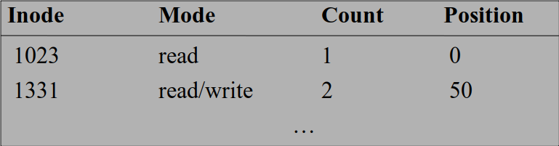
How Kernel works? (The Open File Table)
I/O operations are done on files by first opening them, reading/writing/etc., then closing them.
The kernel maintains a global table containing information about each open file.

Slide 22
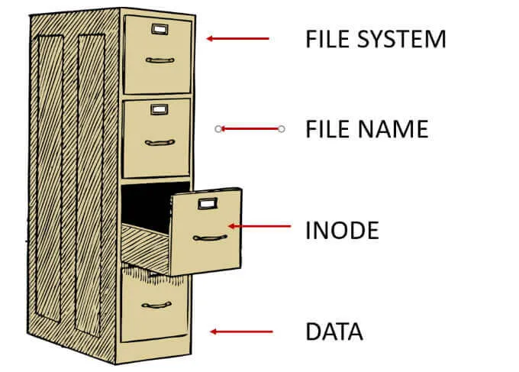
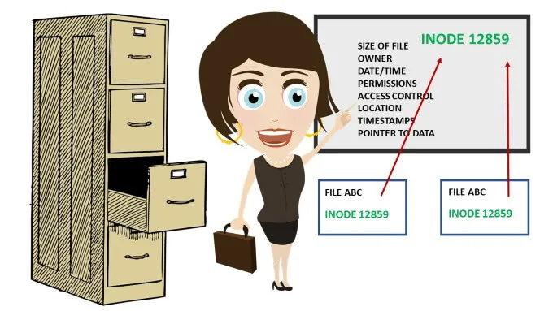
How Kernel works? (index node)
An inode is a data structure. It defines a file or a directory on the file system and is stored in the directory entry. Inodes point to blocks that make up a file. The inode contains all the administrative data needed to read a file. Every file’s metadata is stored in inodes in a table structure.

Slide 23
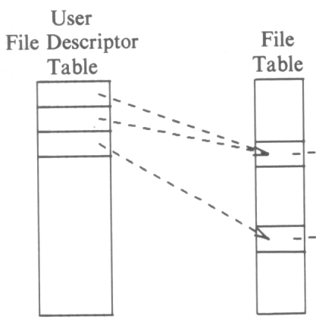
How Kernel works? (The File Descriptor Table)
Each process contains a table of files it has opened.
Each open file is associated with a number or handle, called file descriptor, (fd).
Each entry of this table points to an entry in the open file table.
Starts at 0

Slide 24
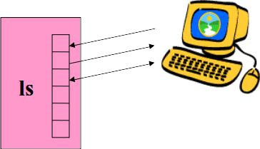
How Kernel works? (Standard in/out/err)
The first three entries in the file descriptor table are preset:
Entry 0 is for input
Entry 1 is for output
Entry 2 is for error messages
By default all go to terminal (/dev/tty)

Slide 25

What is a shell?
The user interface to the operating system
Functionality:
Execute other programs
Manage files
Manage processes
A program like any other
Executed when you log on

Slide 26
Most Commonly Used Shells
/bin/sh The Bourne Shell / POSIX shell
/bin/csh C shell
/bin/tcsh Enhanced C Shell
/bin/ksh Korn shell
/bin/bash Free ksh clone

Slide 27
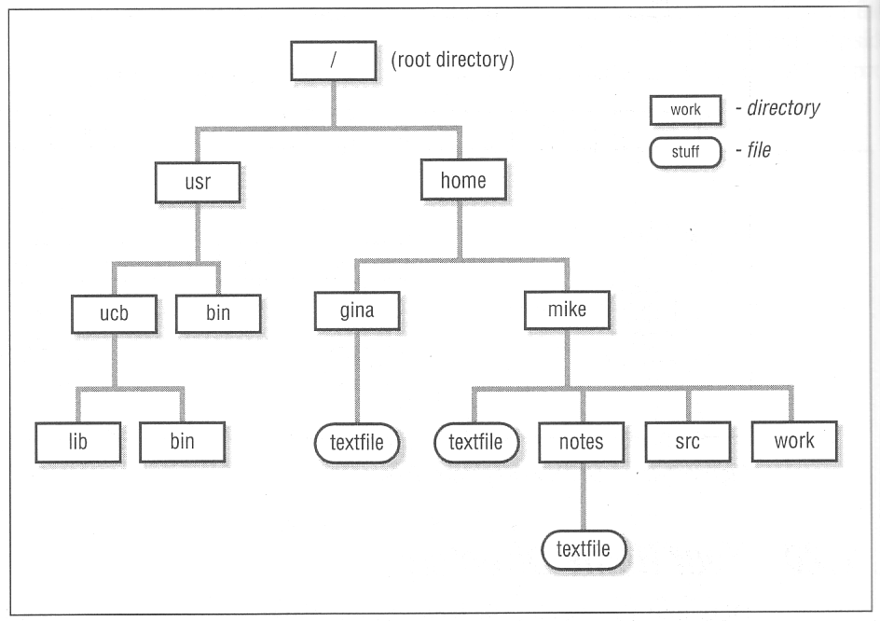
The LINUX File Hierarchy

Slide 28
Lecture 3
Basic Linux/Unix Commands with Examples

Slide 29
Basic Linux commands
Command Description
ls Lists all files and directories in the present working directory
ls-R Lists files in sub-directories as well
ls-a Lists hidden files as well
ls-al Lists files and directories with detailed information like permissions,size, owner, etc.
cd or cd ~ Navigate to HOME directory
cd .. Move one level up
cd To change to a particular directory
cd / Move to the root directory
cat > filename Creates a new file
cat filename Displays the file content
cat file1 file2 > file3 Joins two files (file1, file2) and stores the output in a new file (file3)

Slide 30
Basic Linux commands
Command Description
mv file "new file path" Moves the files to the new location
mv filename new_file_name Renames the file to a new filename
sudo Allows regular users to run programs with the security privileges of the superuser or root
rm filename Deletes a file
man Gives help information on a command
history Gives a list of all past commands typed in the current terminal session
clear Clears the terminal
mkdir directoryname Creates a new directory in the present working directory or a at the specified path
rm dir Deletes a directory
mv Renames a directory

Slide 31
Basic Linux commands
Command Description
pr -x Divides the file into x columns
pr -h Assigns a header to the file
pr -n Denotes the file with Line Numbers
lp -nc , lpr c Prints "c" copies of the File
lp-d lp-P Specifies name of the printer
apt-get Command used to install and update packages
mail -s 'subject' -c 'cc-address' -b 'bcc-address' 'to-address' Command to send email
mail -s "Subject" to-address < Filename Command to send email with attachment

Slide 32
Basic Linux commands
Find all files beneath home directory beginning with f
find ~ -name 'f*' -print
Find all files beneath home directory modified in last day
find ~ -mtime 1 -print
Find all files beneath home directory larger than 10K
find ~ -size 10k -print
Count words in files under home directory
find ~ -exec wc -w {} \; -print
Remove core files
find / -name core –exec rm {} \;

Slide 33
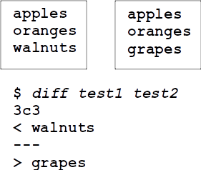
Basic Linux commands
diff: compares two files and outputs a description of their differences
Usage: diff [options] file1 file2
-i: ignore case

Slide 34
Basic Linux commands
Redirection of output: >
example:$ ls > my_files
Redirection of input: <
example: $ cat <input.data
Append output: >>
example: $ date >> logfile
Bourne Shell derivatives: fd>
example: $ ls 2> error_log

Slide 35
Basic Linux commands
cmd 2>file
send standard error to file
standard output remains the same
cmd > file 2>&1
send both standard error and standard output to file
cmd > file1 2>file2
send standard output to file1
send standard error to file2

Slide 36

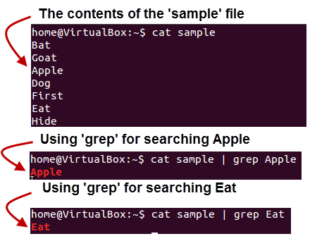
Basic Linux commands
~# cat Filename | more
~# grep search_string
~# sort Filename

Slide 37
Lab#1
Install virtual machine
https://www.oracle.com/virtualization/technologies/vm/downloads/virtualbox-downloads.html
Install a Linux distribution (i.e. Ubuntu)
https://releases.ubuntu.com/20.04.2.0/ubuntu-20.04.2.0-desktop-amd64.iso
Update and upgrade OS (from repository)
Install softwares
Checkup basic OS operation via terminal

Slide 38
Lecture 4
User and Directory Permission

Slide 39
File Permissions
LINUX also provides a way to protect files based on users and groups.
Three types of permissions:
read, process may read contents of file
write, process may write contents of file
execute, process may execute file
Three sets of permissions:
permissions for owner
permissions for group
permissions for other

Slide 40
Directory permissions
Same types and sets of permissions as for files
read: process may a read the directory contents (i.e., list files)
write: process may add/remove files in the directory
execute: process may open files in directory or subdirectories

Slide 41
Utilities for Manipulating file attributes
chmod change file permissions
chown change file owner
chgrp change file group
only owner or super-user can change file attributes
upon creation, default permissions given to file modified by process umask value

Slide 42
Chmod command
Symbolic access modes
example: chmod +r file
Octal access modes
octal read write execute
0 no no no
1 no no yes
2 no yes no
3 no yes yes
4 yes no no
5 yes no yes
6 yes yes no
7 yes yes yes

Slide 43
Lecture 5
Shell Scripting

Slide 44
Scripting vs. C Programming
Advantages of shell scripts
Easy to work with other programs
Easy to work with files
Easy to work with strings
Great for prototyping. No compilation
Disadvantages of shell scripts
Slow
Not well suited for algorithms & data structures

Slide 45
First scripting
~# vim helloWorld.sh
#!/bin/sh
echo Hello World
~# chmod +x helloWorld.sh
~# sh helloWorld.sh

Slide 46
How to work with variable
~# vim helloWorld.sh
#!/bin/sh
MESSAGE="Hello World"
echo $MESSAGE
~# chmod +x helloWorld.sh
~# sh helloWorld.sh

Slide 47
Environmental Variables
NAME MEANING
$HOME Absolute pathname of your home directory
$PATH A list of directories to search for
$MAIL Absolute pathname to mailbox
$USER Your login name
$SHELL Absolute pathname of login shell
$TERM Type of your terminal
$PS1 Prompt

Slide 48
Special Parameters
$# Number of positional parameters
$- Options currently in effect
$? Exit value of last executed command
$$ Process number of current process
$! Process number of background process
$* All arguments on command line
"$@" All arguments on command line
individually quoted "$1" "$2" ...

Slide 50
Control Structures
if expression
then
command1
else
command2
fi

Slide 51
Example of Control Structures
if test "$USER" = "XYZ"
then
echo "I hate you"
else
echo "I like you"
fi

Slide 52
Boolean Operators
Exit value of a program (exit system call) is a number
0 means success
anything else is a failure code
cmd1 && cmd2
executes cmd2 if cmd1 is successful
cmd1 || cmd2
executes cmd2 if cmd1 is not successful
Example:
$ ls bad_file > /dev/null && date
$ ls bad_file > /dev/null || date
Wed Sep 26 07:43:23 2001

Slide 53
Lab#2
Write and execute basic shell scripting
Understanding and implementing proper access

Slide 54
Q&A

Slide 55
End of Basic Linux Understanding
Due to the simplicity as beginner topics, we have only discussed about the basic Linux system. If this program helps our resources development, then we will try to arrange for an advance Linux course

